Slide 1
CMPE 565
Cancer Cells Detection Using Digital Image Processing Methods
Hakan Ahmet Tekin
Muhammed İbrahim ÜNAL

Slide 2
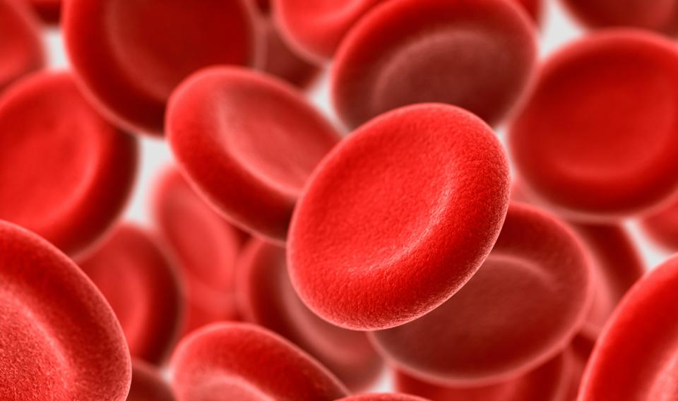
The most vital part of any human body is blood as it keeps one alive. It performs various essential limits, for instance, to trade oxygen, carbon dioxide, and mineral thus on to the whole body. In view of the insights it is been understood that blood cancer is the fifth reason for loss of life in human beings.

Slide 3
What makes the cell cancerous?
How to diagnose a cancer cell ?
What are their attributes?

Slide 4
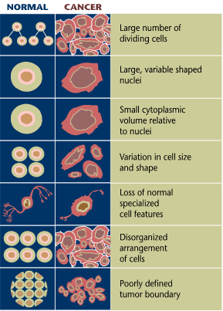
Cancer cells can be found by examining their shapes,numbers,volume etc.

Slide 5
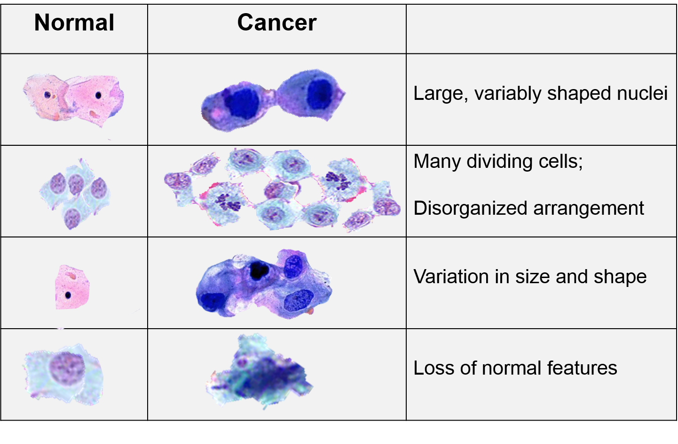

Slide 6
Why computer vision?
Traditional methods of evaluating cancerous tumors are incredibly time consuming.
Based on a limited amount of data, such methods can lead to mistakes and they're prone to subjectivity.

Slide 7
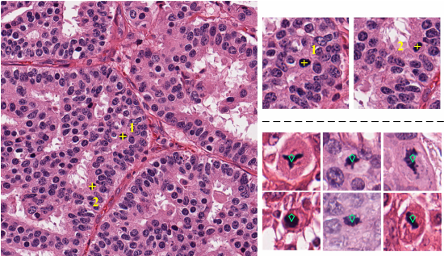
Using computer vision technology and deep learning models increases the speed and accuracy of chemotherapy response assessments, doctors can identify cancer patients who are candidates for surgery faster, and with lifesaving precision.

Slide 8
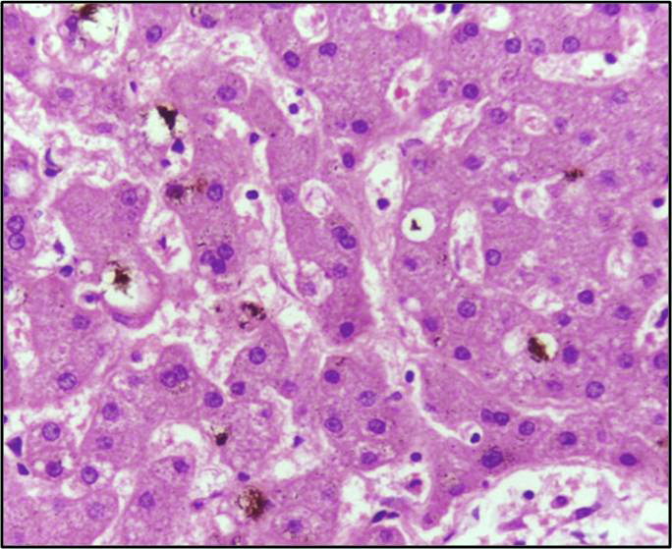
Small details might be overlooked, So it should not be risked in diagnose process

Slide 9
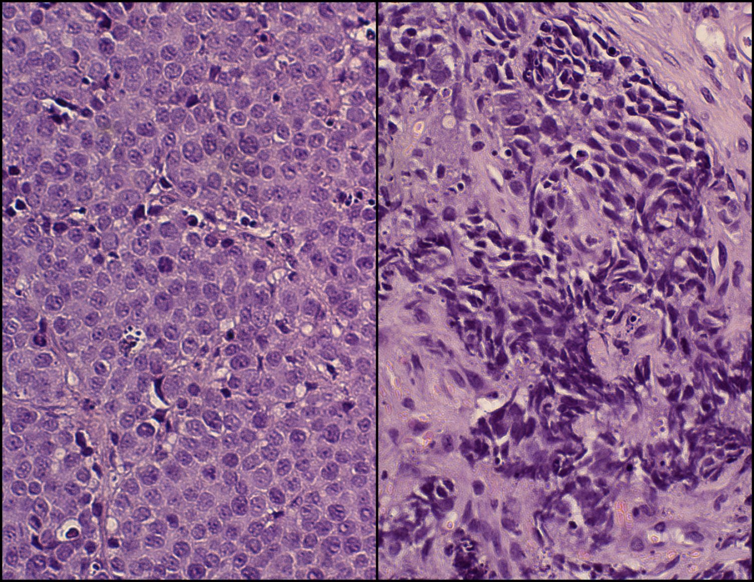
Comparison of healthy and cancerous prostate cell
It is often obvious for us to conclude whether cells are cancerous or not.

Slide 10
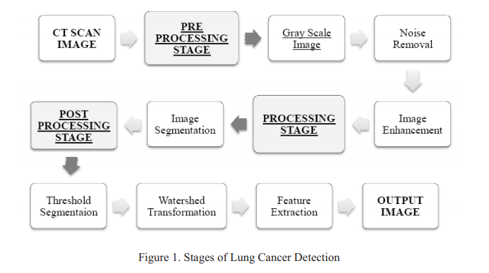
How to detect cancer cells ?

Slide 11
Image Acquisition
Advantage of the computer tomography image having better clarity, low noise and distortion For the experimental purpose 10 male images are examined his CT scans were stored in database of images in JPEG/PNG image standards.
Image pre-processing
Noise Removal
Image Enhancement
Image enhancement defined as a way to improve the quality of image

Slide 12
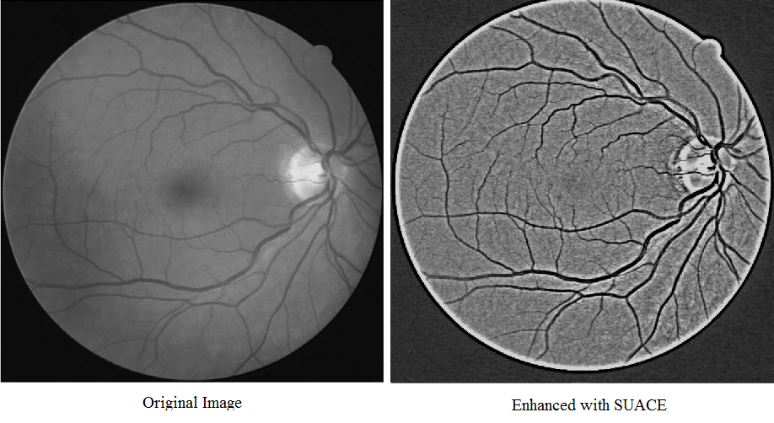

Slide 13
Processing
This stage involves mainly segmentation.
Image Segmentation
In computer vision, segmentation refers to the process of partitioning a digital image into multiple segments.
The main aim of segmentation is simplification i.e. representing an image into meaningful and easily analyzable way

Slide 14
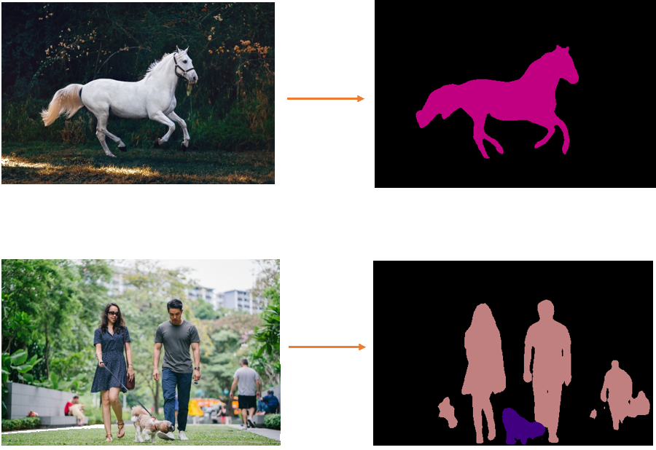

Slide 15
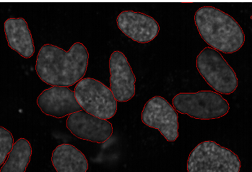
Here, we can clearly see the shapes of all the cancerous cells. There are many other applications where Image segmentation is transforming industries:
Traffic Control Systems
Self Driving Cars
Locating objects in satellite images

Slide 16
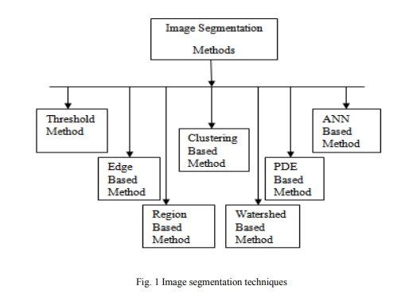
There are several existing techniques which are used for image segmentation.
These all techniques have their own importance.

Slide 17
Region-based Segmentation
One simple way to segment different objects could be to use their pixel values. Pixel values will be different for the objects and the image’s background if there’s a sharp contrast between them.
In this case, we can set a threshold value. The pixel values falling below or above that threshold can be classified.
This technique is known as Threshold Segmentation.

Slide 18
Edge Detection Segmentation
There is always an edge between two adjacent regions with different grayscale values (pixel values). The edges can be considered as the discontinuous local features of an image.
We can make use of this discontinuity to detect edges and hence define a boundary of the object. This helps us in detecting the shapes of multiple objects present in a given image.

Slide 19
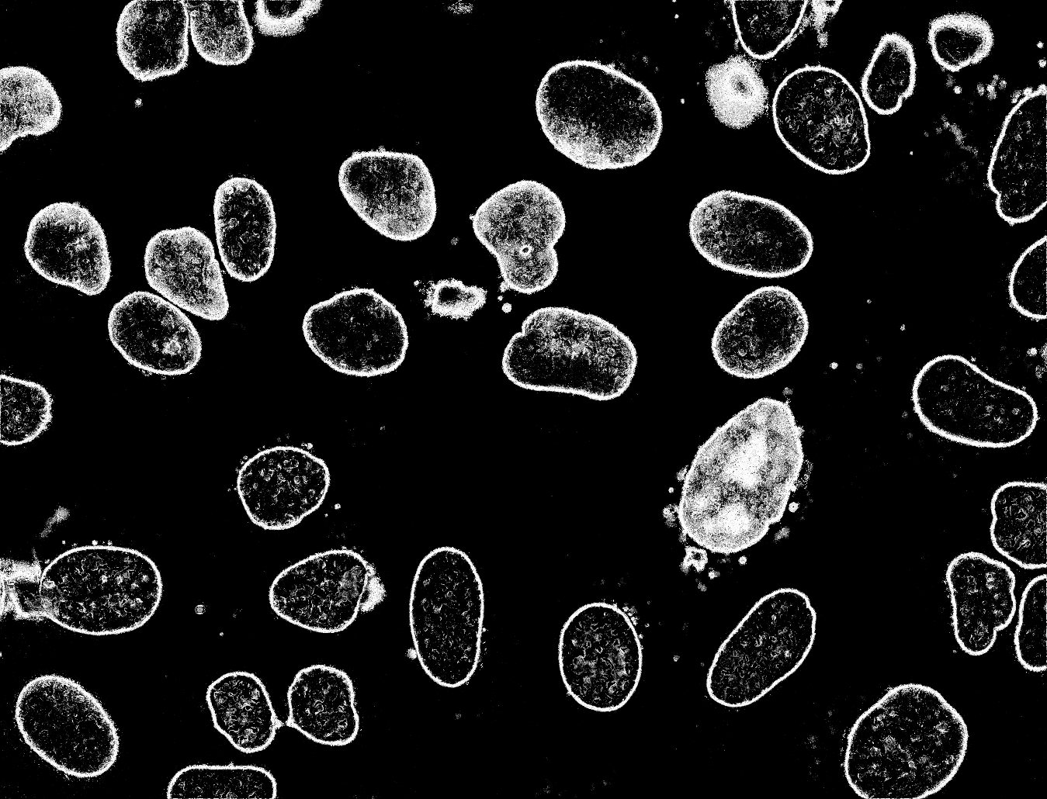

Slide 20
Image Segmentation based on Clustering
Clustering is the task of dividing the population (data points) into a number of groups, such that data points in the same groups are more similar to other data points in that same group than those in other groups. These groups are known as clusters.
One of the most commonly used clustering algorithms is k-means. Here, the k represents the number of clusters

Slide 21
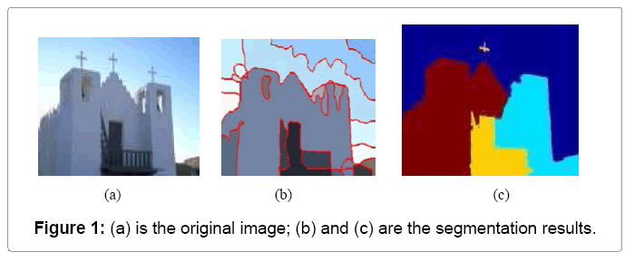
Example of segmentation based on clustering

Slide 22
Feature in Computer Vision
Feature is a piece of information which is relevant for solving the computational task related to a certain application.
Features may be specific structures in the image such as points, edges or objects.

Slide 23
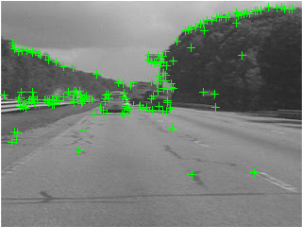

Slide 24
Different Feature Extraction Approaches
SIFT (Scale-Invariant Feature Transform)
HOG (Histogram of Oriented Gradients)
CNN (Convolutional Neural Network )

Slide 25
SIFT
Matching features across different images in a common problem in computer vision. When all images are similar in nature (same scale, orientation, etc) simple corner detectors can work. But when you have images of different scales and rotations, you need to use the Scale Invariant Feature Transform.

Slide 26
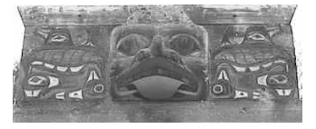
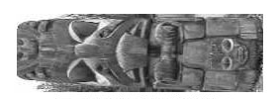
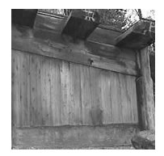
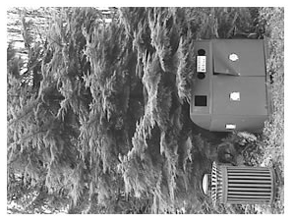
Images with different scale and rotations

Slide 27
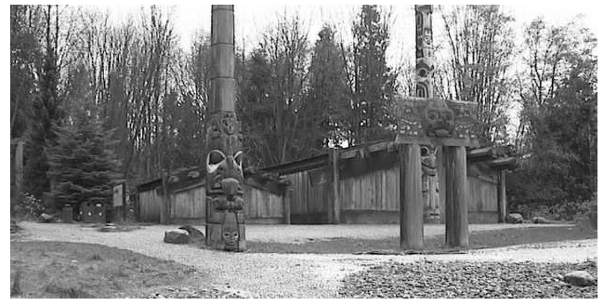
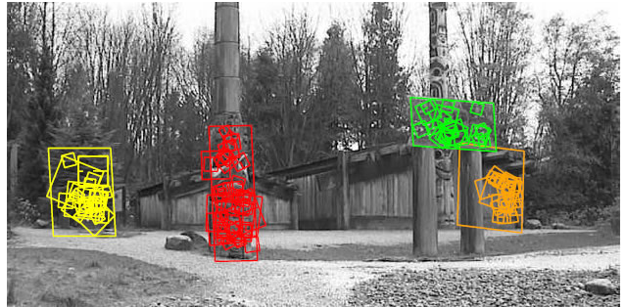

Slide 28
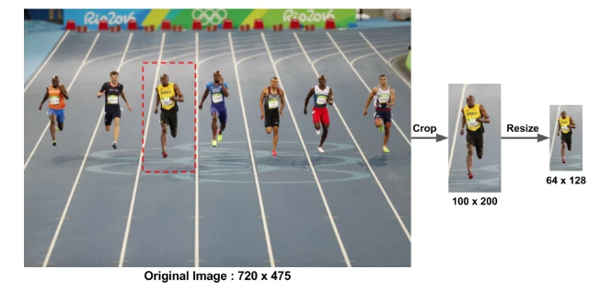
Histogram of Orianted Gradient
Preprocessing
This patch is cropped out of an image and resized to 64×128. Now we are ready to calculate the HOG descriptor for this image patch.

Slide 29
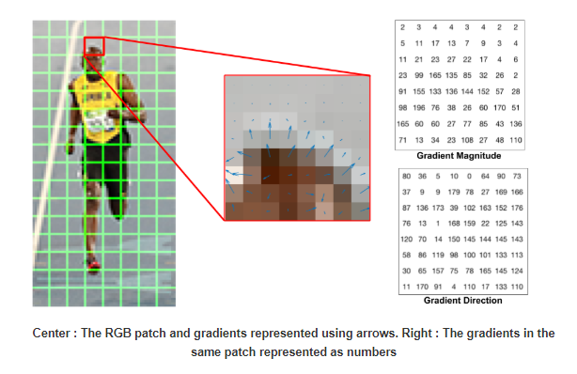

Slide 30
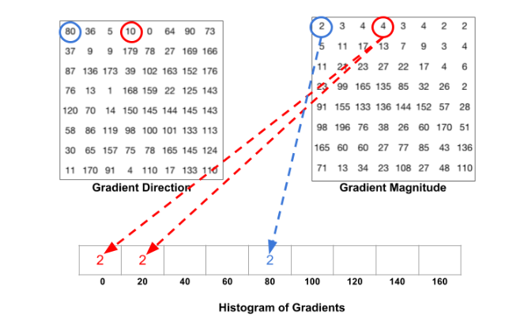

Slide 31
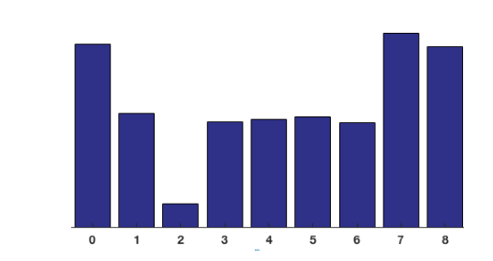
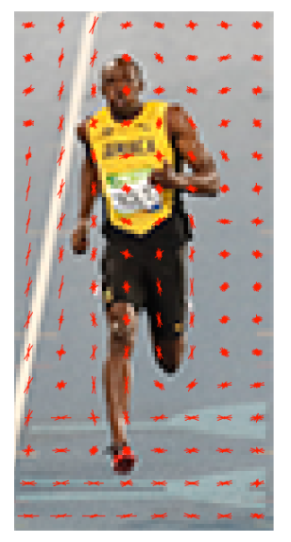
The contributions of all the pixels in the 8×8 cells are added up to create the 9-bin histogram.
You will notice that dominant direction of the histogram captures the shape of the person, especially around the torso and legs.

Slide 32

Convolutional Neural Networks
Input image (starting point)
Convolutional layer (convolution operation)
Pooling layer (pooling)
Input layer for the artificial neural network (flattening)

Slide 33
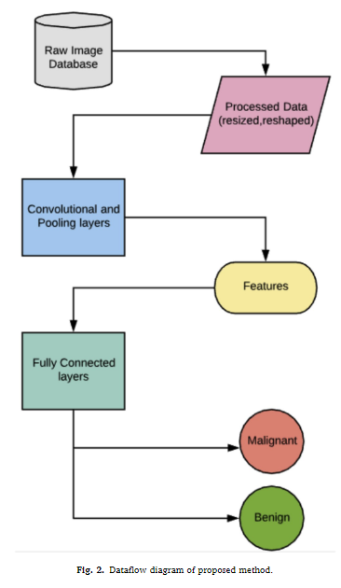
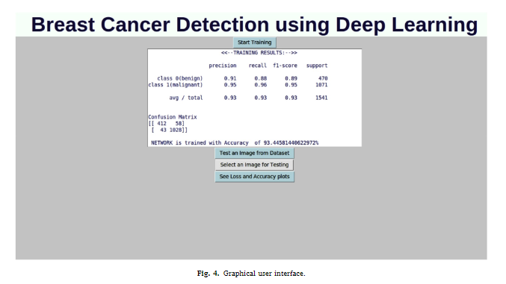
Cancer diagnosis in histopathological image: CNN based approach Sumaiya Dabeer*, Maha Mohammed Khan, Saiful Islam Department of Computer Engineering Zakir Husain College of Engineering and Technology Aligarh, India

Slide 34
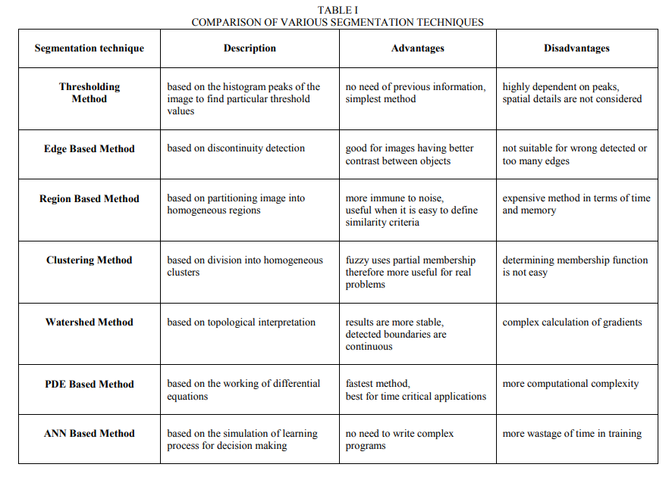

Slide 35
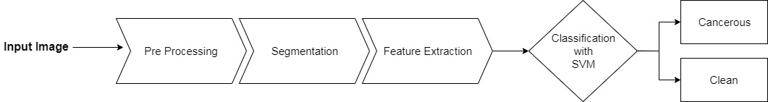
What we are going to do
We are going to find wether a given image contains cancer cells or not. The process we are going to follow is given below.

Slide 36
Pre Processing
Pre processing is the name of operations that are used to enhance an image according to the task at hand.
Grayscaling
Blurring
Sharpening
Intensity Adjustment
Contrast Enhancing

Slide 37
Segmentation
Need to find cells before extracting features
Determining the Background and Foreground
Otsu’s Method
Finding separate cells
Marker Controlled Watershed Segmentation

Slide 38
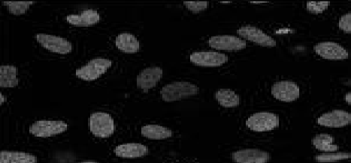
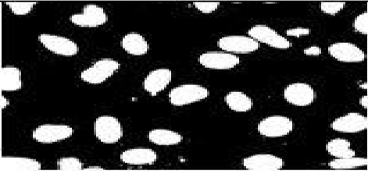
Threshold Segmentation
We are going to use it for removing backgrond by using Otsu’s Method.
Result of Otsu’s method on homogenous cell image:

Slide 39
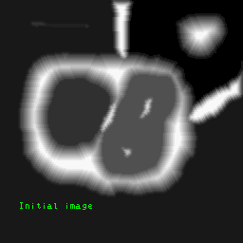
Watershed Segmentation
Treats the image like a topographic map, with the brightness of each point representing its height, and finds the lines that run along the tops of ridges.
Gives accurate results with high detail.
Used for finding overlapping objects.

Slide 40
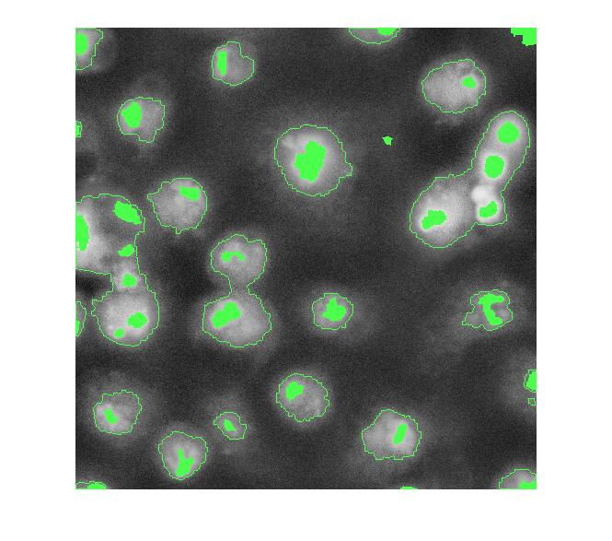
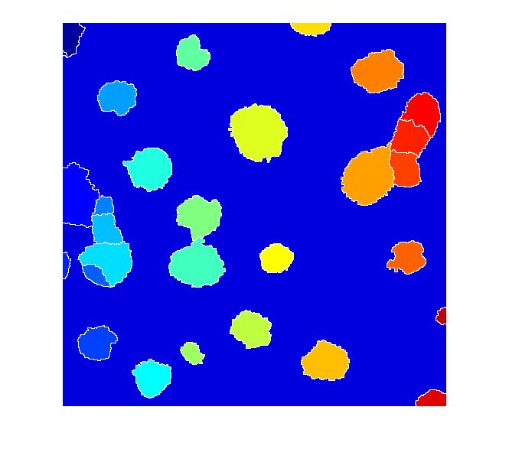
Marker Controlled Watershed Segmentation
Local minima of the gradient of the image may be chosen as markers.

Slide 41
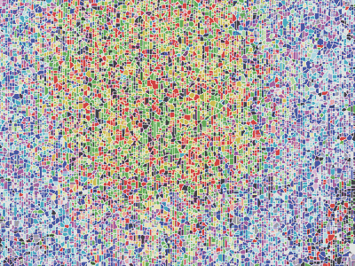
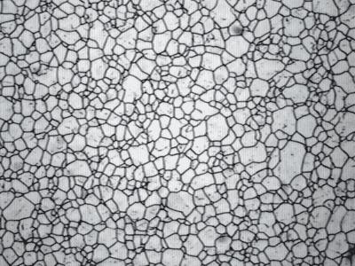
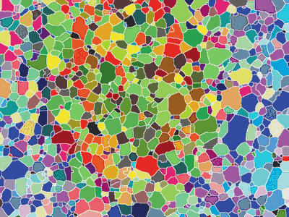
Over Segmentation
Over Segmentation occurs in Watershed process because every regional minimum forms its own basin.
We can use h-transform for handling this problem.

Slide 42
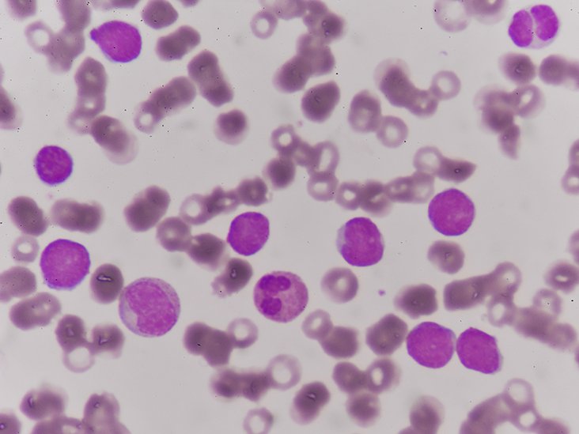
Feature Extraction
After the cells are found, we need to extract their features.
3 key attributes are:
Color
Shape
Radius

Slide 43
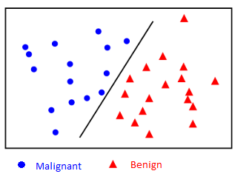
Classification
Gathered features will be put to a Support Vector Machine (SVM), for determining wheter a given image is malignant (cancerous) or not.

Slide 44
However number of features might be greater than the number of samples.
To avoid over-fitting, regularization term is crucial.
Finding a suitable Regularization Parameter is the key.

Slide 45
Algorithms and tools that we are going to use
Watershed segmentation
Otsu’s Method
SIFT
SVM
Hough Transform
Matlab

Slide 46
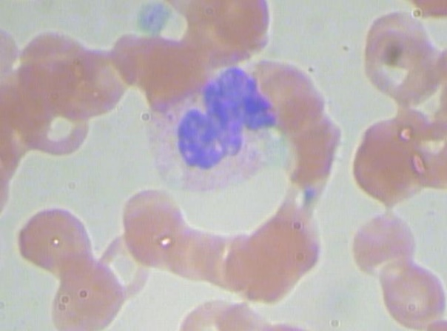
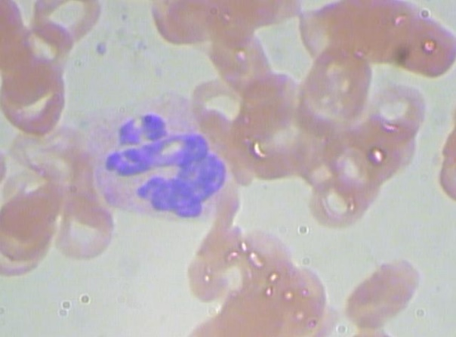
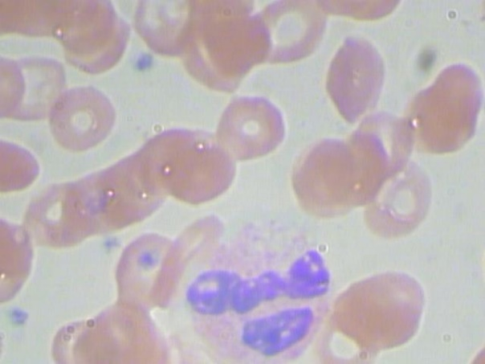

Samples From Our Data

Slide 47
References
http://journal.utem.edu.my/index.php/jtec/article/view/1732 - Improved Thresholding Method for Cell Image Segmentation Based on Global Homogeneity Information - Kazeem Oyeyemi Kazeem
https://en.wikipedia.org/wiki/Otsu%27s_method
https://www.learnopencv.com/histogram-of-oriented-gradients/
https://www.researchgate.net/publication/320947210_Machine_Learning_Approaches_in_Cancer_Detection_and_Diagnosis_Mini_Review
https://www.kaggle.com/paultimothymooney/blood-cells#labels.csv
https://ieeexplore.ieee.org/stamp/stamp.jsp?tp=&arnumber=7807865

